Slide 1



Exploring the Effect of Multiple Natural Languages on Code Suggestion Using GitHub Copilot
◎Kei Koyanagi, Dong Wang, Kotaro Noguchi, Masanari Kondo
Alexander Serebrenik, Yasutaka Kamei, Naoyasu Ubayashi
Notes:
Hello everyone
I’m kei koyanagi.
Today, I will talk about my paper, Exploring the effect of multiple natural languages on code suggestion using github copilot

Slide 2

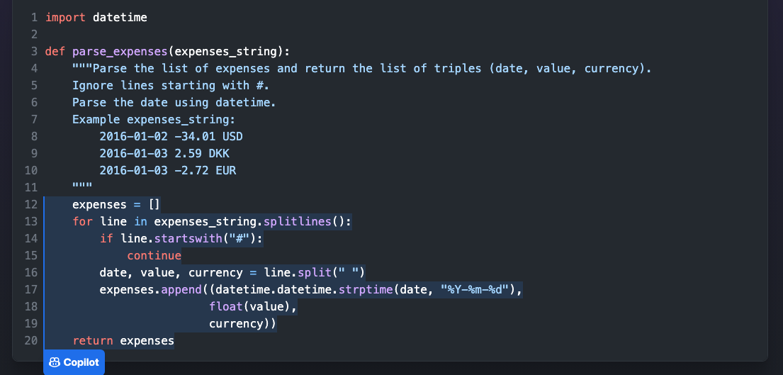
Background: Development using AI
GitHub Copilot (Coding Support)
Input
Recommendation
Notes:
These days, most people have developed applications, using various tools.
Github copolit is one of the coding support tools, and some of you may use it.
It suggests code snippets and libraries in different programming languages to developers based on
comments that describe specifications and the code being written.
This shows a screen shot of the actual coding support.
copilot recommends the code according to the input.
At first, we describe what we want to do in this process.
In this picture, the blue text represents it.
Then, copilot regards the comment as input, and this tool recommends the code according to it.

Slide 3

Background: The effect of input language
GitHub Copilot
Input
Output
Correct Answer
in English
Wrong Answer
in Japanese
We should give appropriate input to use AI efficiently.
Notes:
However, this method has still many problems.
One of the issues is the effect of input language.
For instance, if we input comment in English, we will get correct answer.
On the other hand, if we input in Japanese, we may receive wrong answer.
Thus, we should give appropriate input to leverage artificial intelligence efficiently,
but we have had no idea about what language is the most suitable for each task.

Slide 4


Goal: Understand how language differences affect GitHub Copilot performance
Japanese
Which language
is the best?
English
GitHub Copilot
Chinese
Notes:
Therefore, the purpose of my research is investigating how language differences affect github copilot performance using Japanese, English, and Chinese.

Slide 5


Experiment
AtCoder
Japanese
English
Chinese
Software Researcher
(with 6-year experience)
Chinese
Notes:
Before the results, please let me show the experiment specifications briefly.
To begin with, we collected questions in Japanese and English from Atcoder, which is one of the most popular programming contest in Japan.
Please note that problems in Chinese has not been given by Atcoder,
so a native Chinese speaker with over five years experience in software engineering inspected all questions translated by DeepL.

Slide 6
Experiment
AtCoder
Japanese
A
B
C
D
Easy
Medium
Hard
Each difficulty has 189 problems
English
Chinese
Software Researcher
(with 6-year experience)
Chinese
Notes:
Then, each dataset has 4 different difficulties and A is similar to Easy problems on LeetCode.
B and C corresponds to medium, and D is like hard on LeetCode.
Each difficulty includes 189 problems, so a dataset has 756 questions totally.

Slide 7
Experiment
AtCoder
Japanese
Suggestions
English
GitHub
Copilot
Suggestions
Chinese
Software Researcher
(with 6-year experience)
Suggestions
Chinese
Notes:
Then, we input these datasets into copilot, and got suggestions.
Taking into account the randomness of Copilot, recommendations were obtained five times for each question.

Slide 8

Results: Japanese recorded the highest $Accuracy$
English
Japanese
Chinese
68.1%
54.3%
Med.
A
Ave.
Mid.
B
Ave.
28.9%
11.0%
Mid.
C
Ave.
Mid.
D
Ave.
Notes:
Finally, please let me share the results.
These graphs summarize the median and average accuracies for English, Japanese, and Chinese, categorized by question difficulty.
In each graph, blue, green, and orange represents English, Japanese, and Chinese accuracies respectively.
According to the graph, we can find that input in Japanese was the highest accuracy in all difficulties.
And the accuracy of difficulty A was 68.1%

Slide 9
Results: Japanese recorded the highest $Accuracy$
English
Japanese
Chinese
4.5%
16.0%
54.3%
English words couldn’t be recognized as symbols.
Med.
A
Ave.
Mid.
B
Ave.
The impact of creating the dataset through translation.
28.9%
11.0%
Mid.
C
Ave.
Mid.
D
Ave.
Notes:
Focusing on the accuracy differences between languages for difficulty A,
the difference between Japanese and English was 4.5%, and that between Japanese and Chinese was 16.0%.
Especially, the difference with Chinese was significant.
As a possible reason, since the output format of strings in AtCoder is in Roman characters or English words,
the Chinese dataset used as input contained Roman characters or English words.
These were possibly not recognized as symbols, or the impact of creating the dataset through translation could be considered.
To sum up, it doesn't necessarily mean that English is always better.
We have to choose an appropriate language for each task.

Slide 10
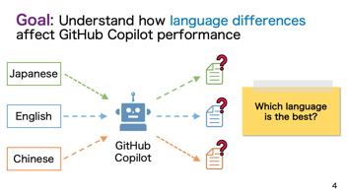
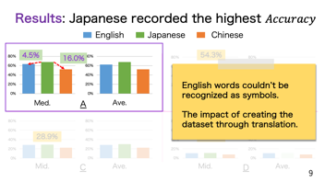
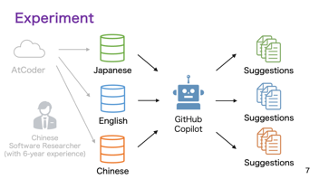
Summary: The capability varies across natural languages.
Contact:
Email: kondo@ait.kyushu-u.ac.jp
Twitter: @masanari_kondo
Notes:
This is the summary slide.
Thank you

Slide 11


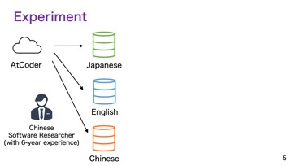
Summary: The capability varies across natural languages.
Notes:
This is the summary slide.
Thank you

Slide 12
Summary: The capability varies across natural languages.
Notes:
As the result, Japanese was the highest score compared to English and Chinese.
This is the remarkable consequence because it is known empirically that English is the best.
Of course, I need to experiment with additional dataset because this research only focused on specific data.
In brief, I have discussed the background, the purpose, and the result of my research.
This research would contribute to more efficient use of artificial intelligence, which would cut development costs in half.
That’s all. Thank you for listening.
As the root, it is unclear what language to use, and uncovering the difference of three input language is the objective.
Moreover, Japanese was the best in this research consequently, but additional experiment is still needed.

Slide 13
Result (Precision)
Japanese
English
Chinese
68.1%
63.6%
52.1%
Remarkable consequence
(it is known empirically that English is the best)
I need to experiment with additional dataset.
Notes:
As the result, Japanese was the highest score compared to English and Chinese.
This is the remarkable consequence because it is known empirically that English is the best.
Of course, I need to experiment with additional dataset because this research only focused on specific data.
In brief, I have discussed the background, the purpose, and the result of my research.
This research would contribute to more efficient use of artificial intelligence, which would cut development costs in half.
That’s all. Thank you for listening.
As the root, it is unclear what language to use, and uncovering the difference of three input language is the objective.
Moreover, Japanese was the best in this research consequently, but additional experiment is still needed.

